Slide 1
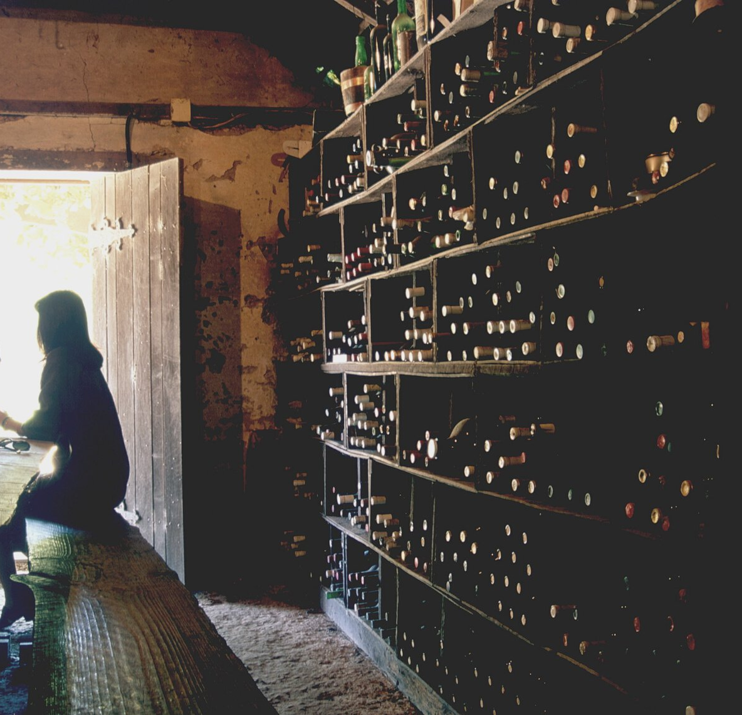
Does Alcohol Solve All Your Problems?
Group 8
(By presentation order)
Keer Ma, Weikun Zhuang, Yuanyi Xie, Xiaoya Gao

Slide 2
Our team intends to find out international trends in alcohol consumption.
What we are interested in is if real-world data conform to drinking stereotypes.
Introduction
1) Which country is the happiest?
2) Which country has the most alcohol consumption?
3) What kind of alcohol does each country like the most?
4) How does alcohol consumption relate to happiness score?

Slide 3
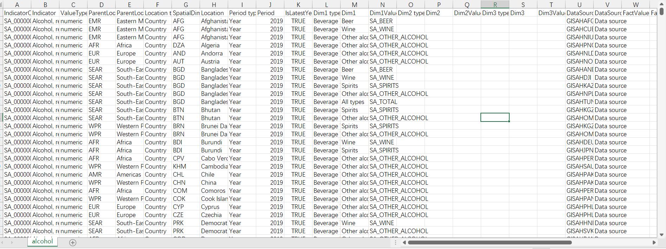
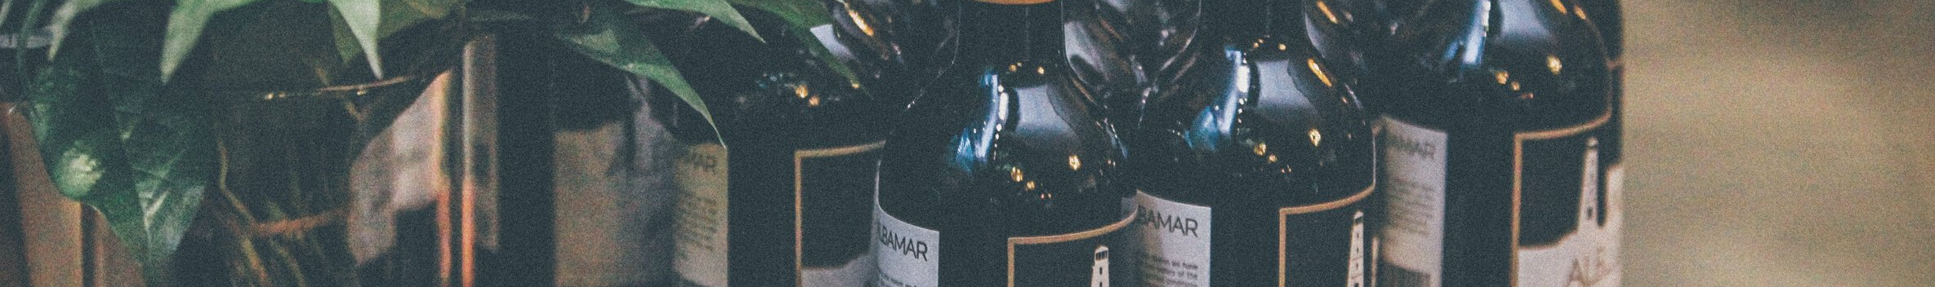
[Alcohol Data]
WHO has national data on average alcohol consumption per capita for those aged 15 and over in each country. The data also describes consumption by beverage type: wine, beer, spirits and other alcoholic beverages
Dataset
47795 (rows)×34 (columns)
[Alcohol Data] https://www.who.int/data/gho/data/indicators/indicator-details/GHO/alcohol-recorded-per-capita-(15-)-consumption-(in-litres-of-pure-alcohol)

Slide 4
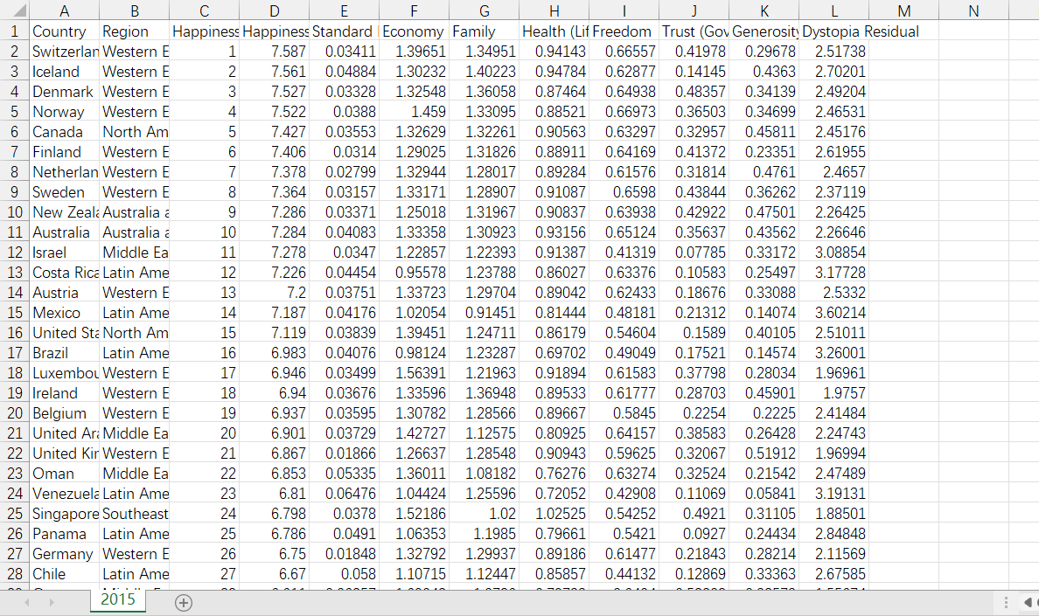
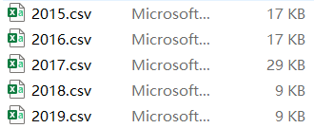
[Happiness Scores]
The Happiness Score is a national average of the responses to the main life evaluation question asked in the Gallup World Poll (GWP).
This data contains the Happiness Score for 153 countries, which is explained by the following factors: GDP per capita, Healthy Life Expectancy, Social support and others
Dataset
159 (rows)×12 (columns)×5 (files)
[Happiness Scores Data] https://www.kaggle.com/mathurinache/world-happiness-report-20152021

Slide 5
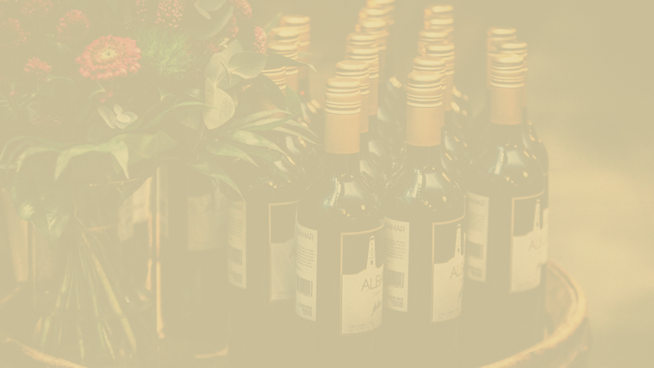

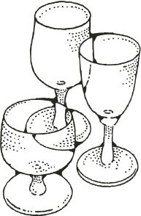
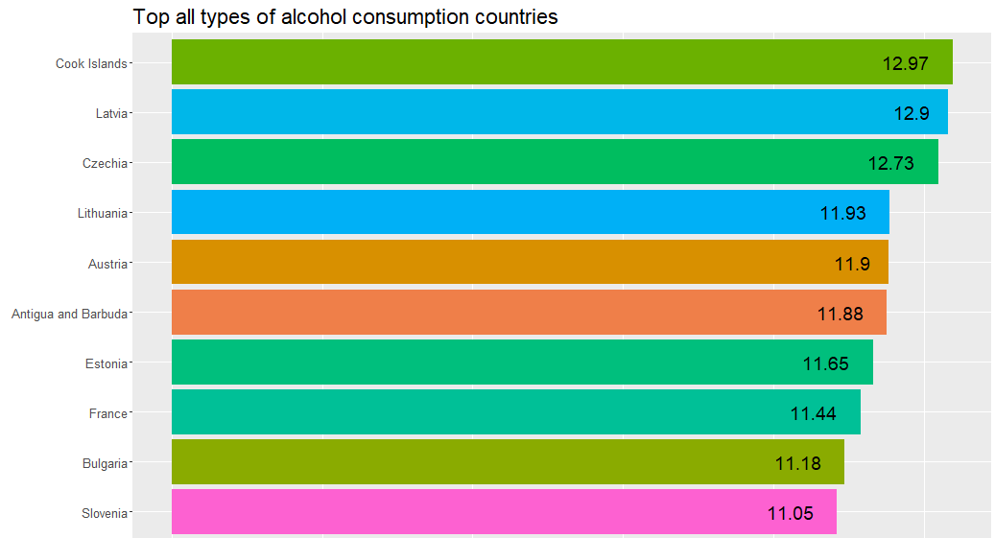
Which Country Has the Most Alcohol Consumption?
Alcohol Consumption
All types of alcohol in 2019
Top 10 countries are:
Cook Island
Latvia
Czechia
Lithuania
Austria
Antigua and Barbuda
Estonia
France
Bulgaria
Slovenia

Slide 6
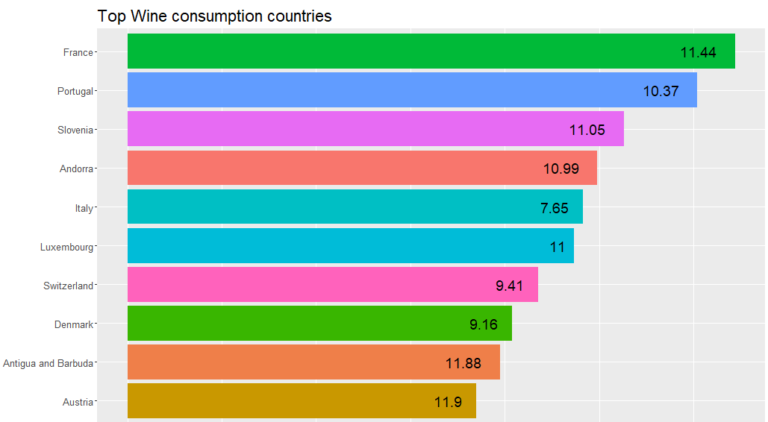
Which Country Has the Most Alcohol Consumption?
Alcohol Consumption
Wine in 2019
Top 10 countries are:
France
Portugal
Slovenia
Andorra
Italy
Luxembourg
Switzerland
Denmark
Antigua and Barbuda
Austria

Slide 7
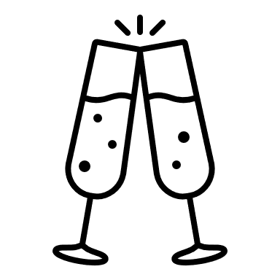
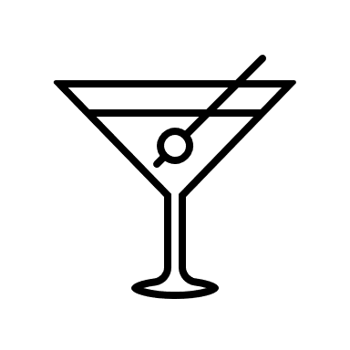
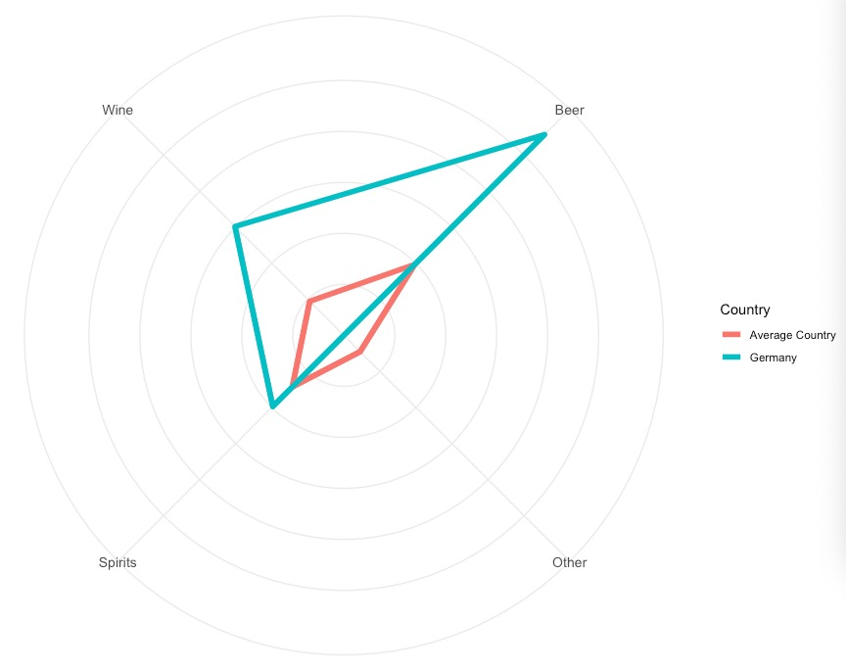
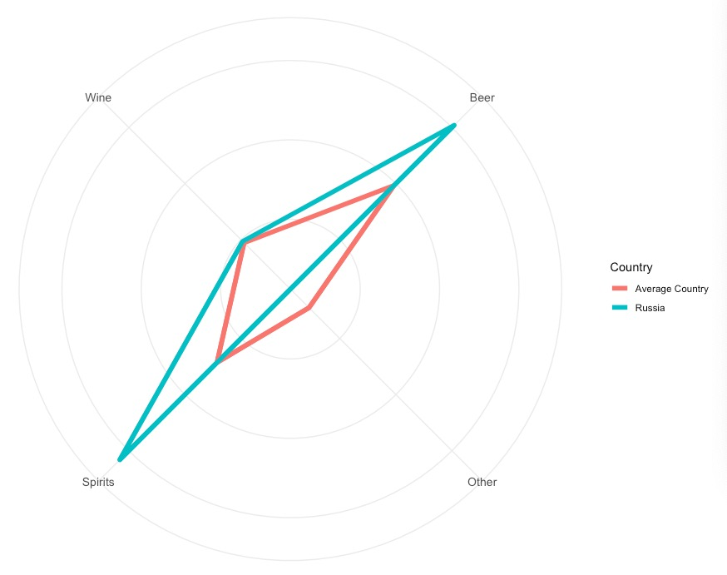
Which Type Alcohol They Like Best?
HARLEE REGAN
Germany
Russia
2019
Germany likes Beer best
2019
Russia likes beer and spirits(Vodka) best.

Slide 8
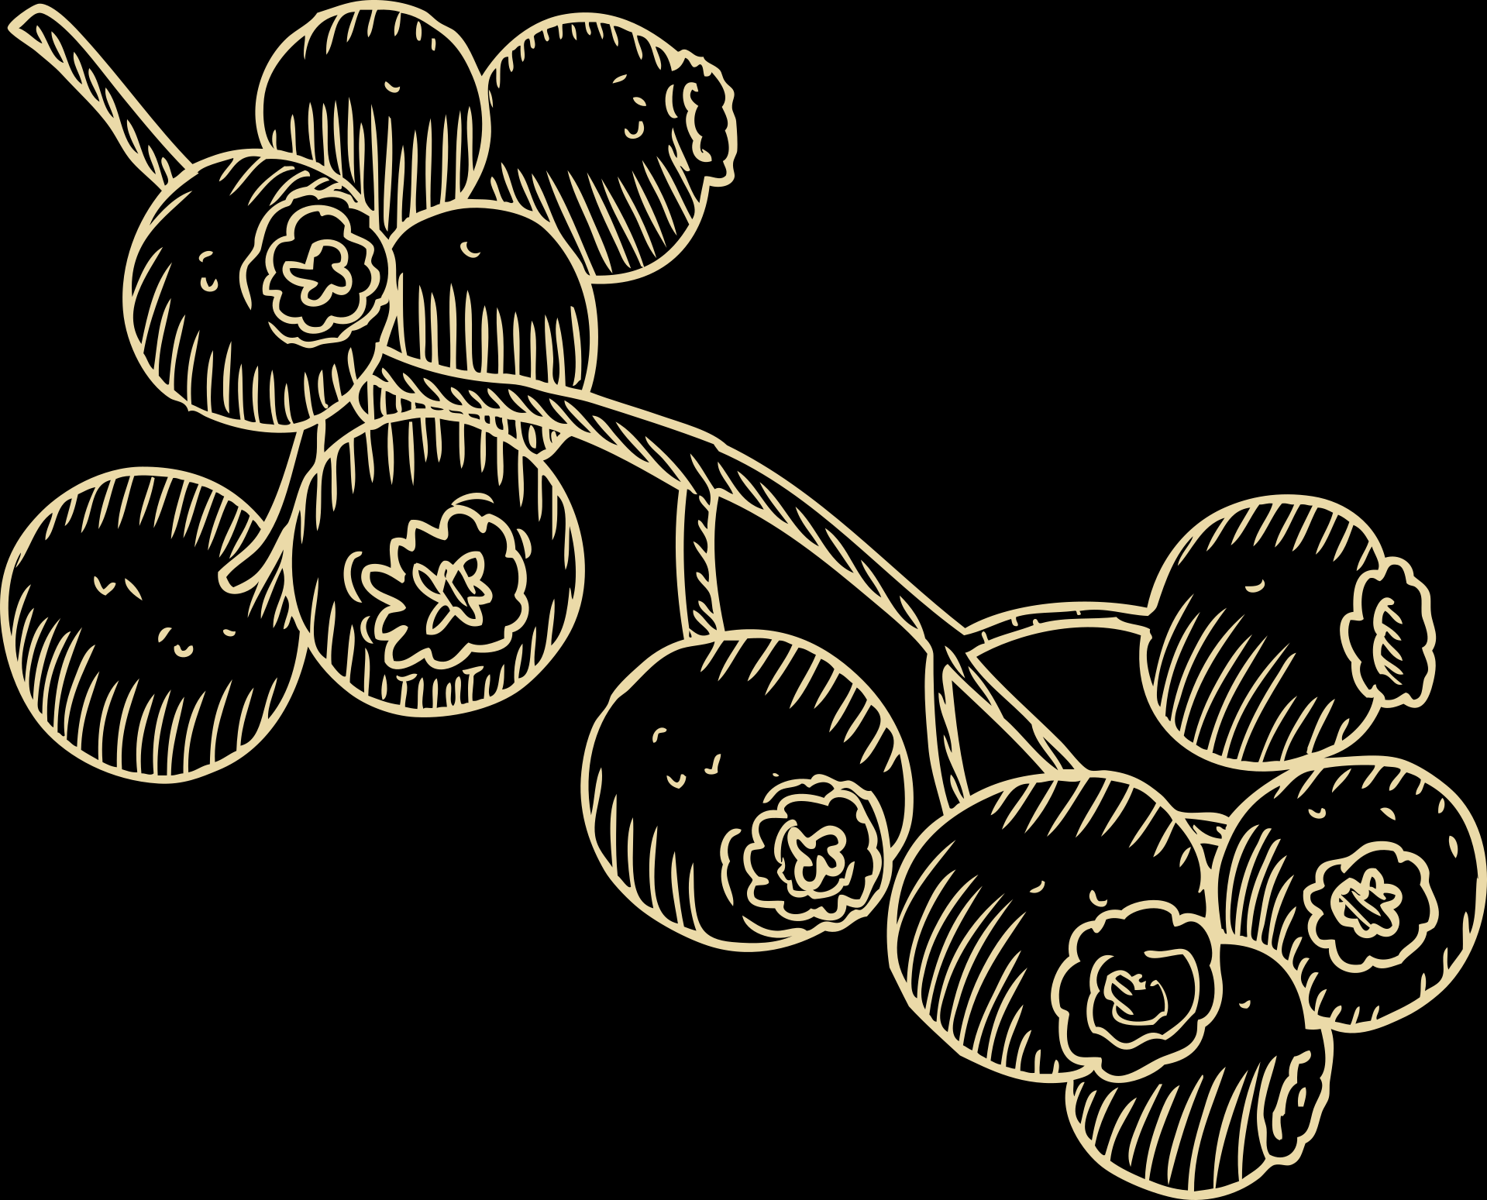
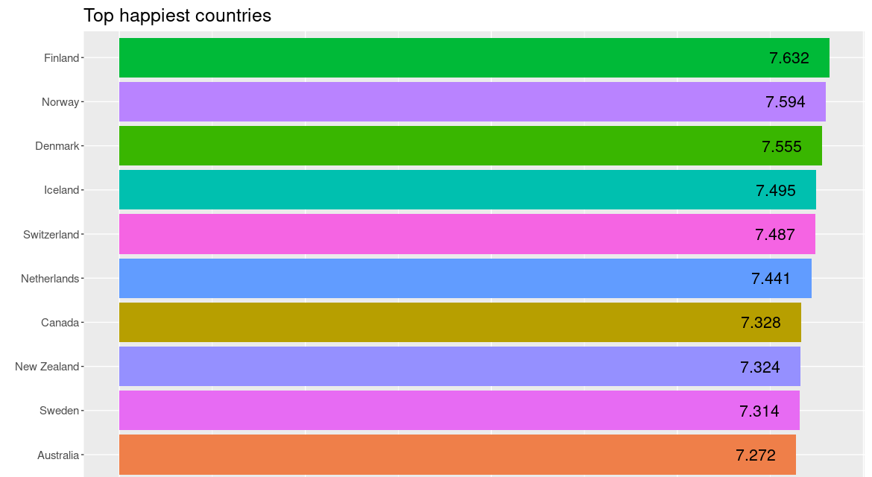
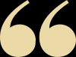
Which Country is the Happiest?
2018
Finland, Norway,
Denmark, Iceland,
Switzerland, Netherland,
Canada, New Zealand,
Sweden, Australia

Slide 9
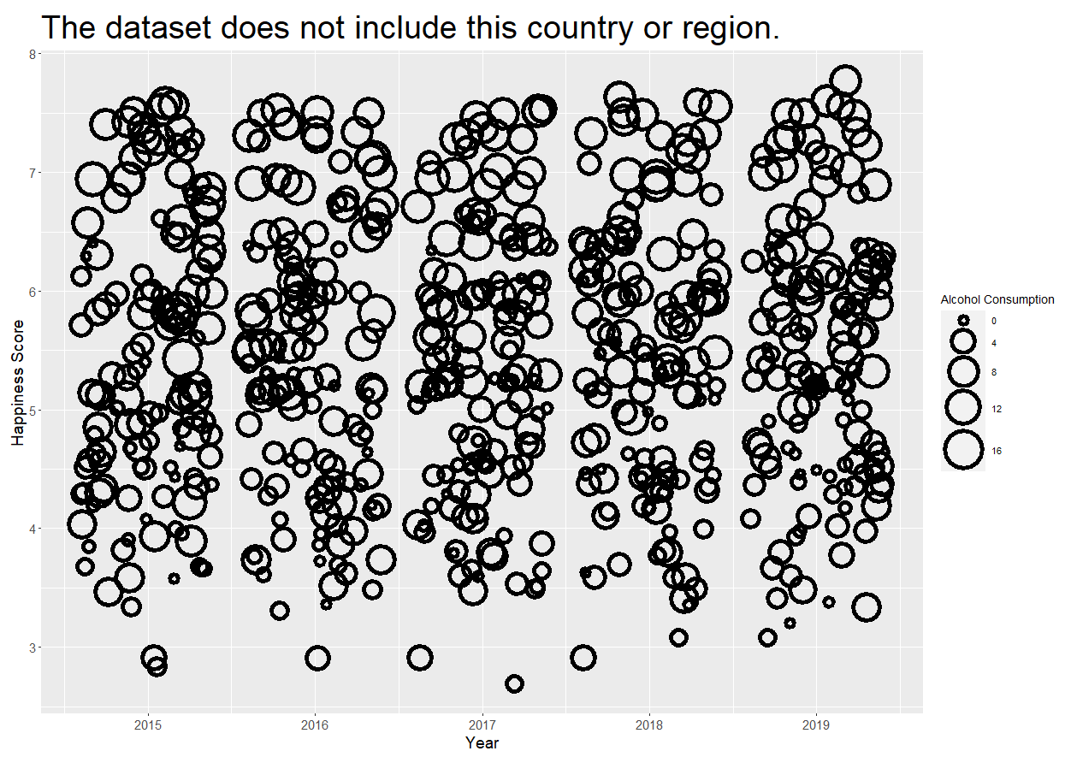
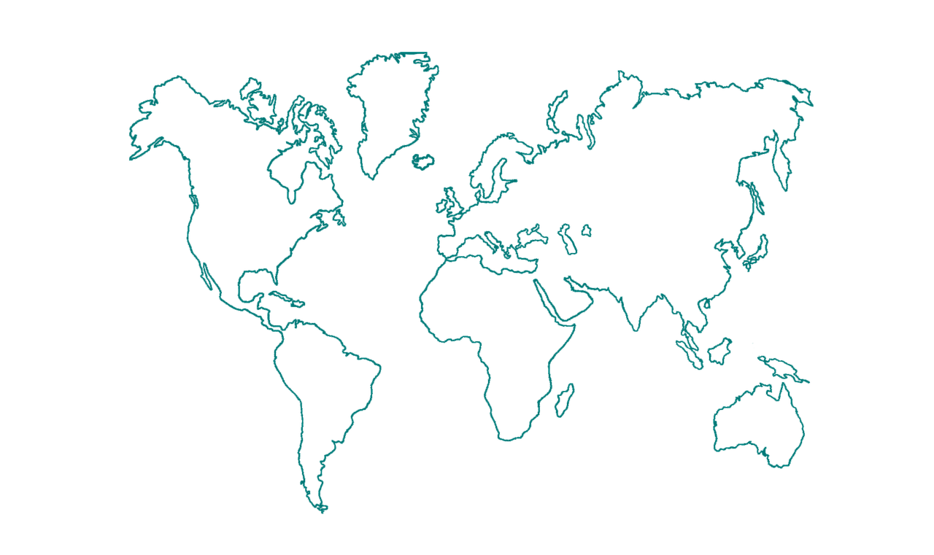
All Countries and Regions Relationship
Positive Relationship?
Most of smaller rings is in the lower happiness score section. Most of bigger rings is in the higher happiness score section.

Slide 10
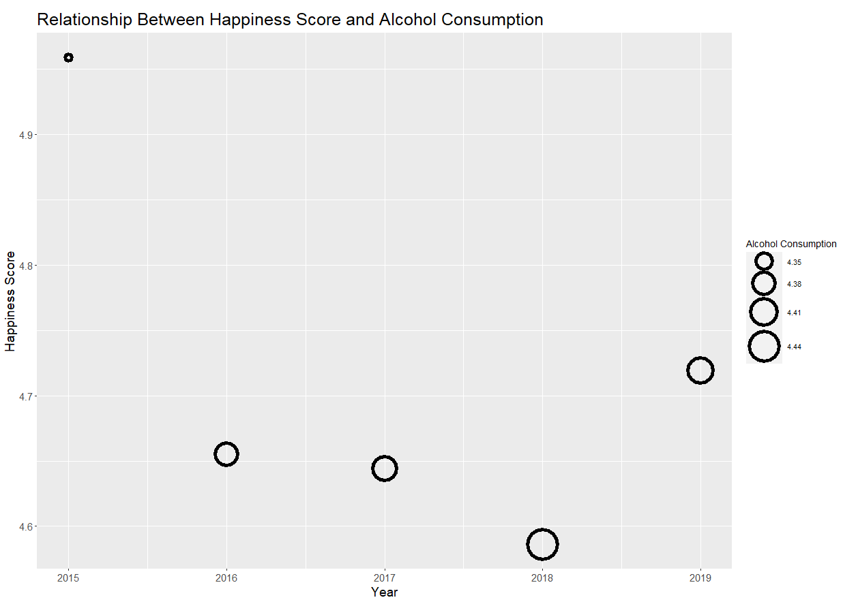
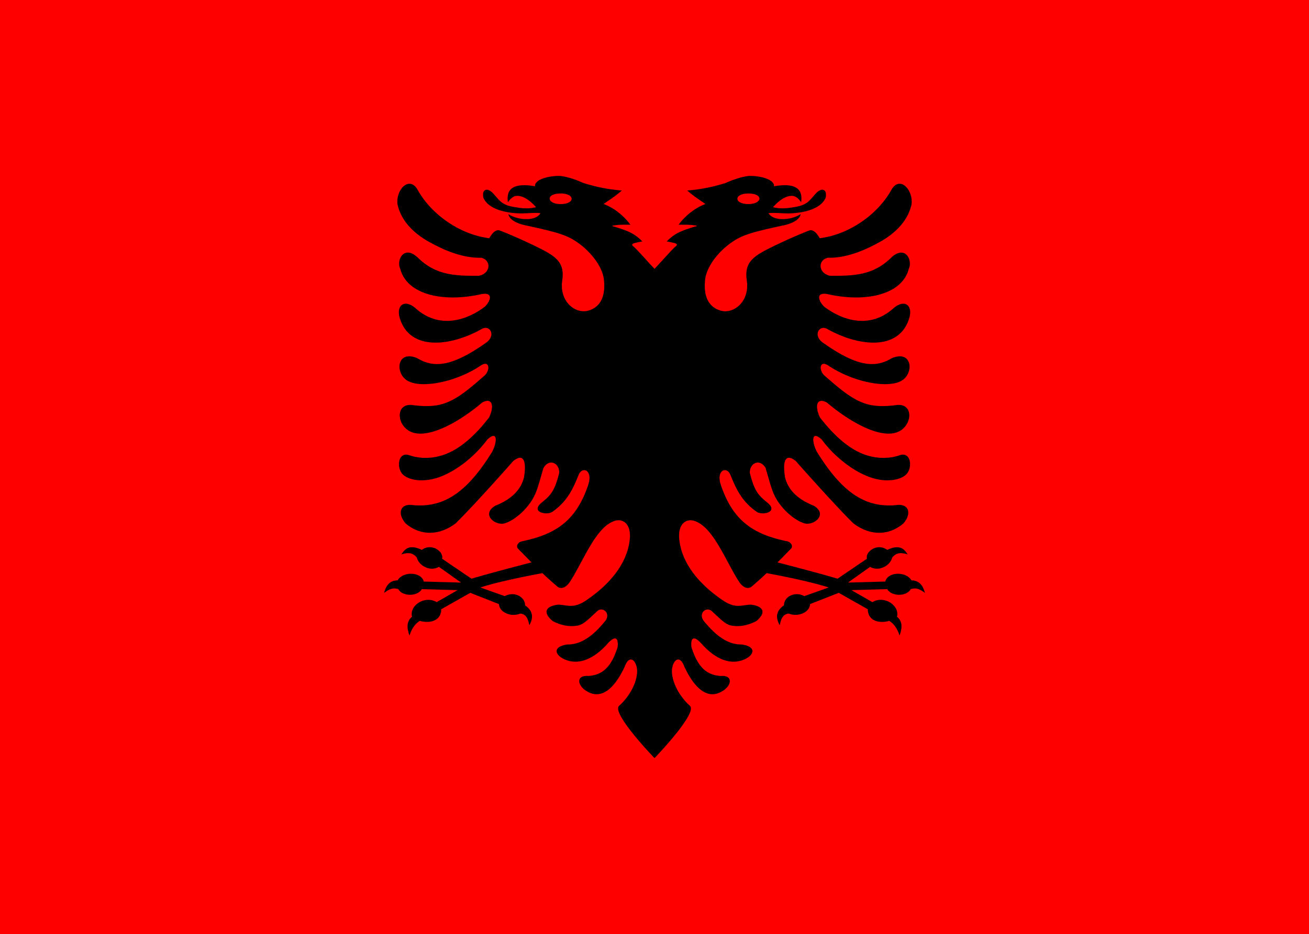

For Albania
Negative?
Year: 2015-2019
As the picture shows, higher happiness score corresponds to lower alcohol consumption. Conversely, lower happiness score corresponds to higher alcohol consumption.

Slide 11
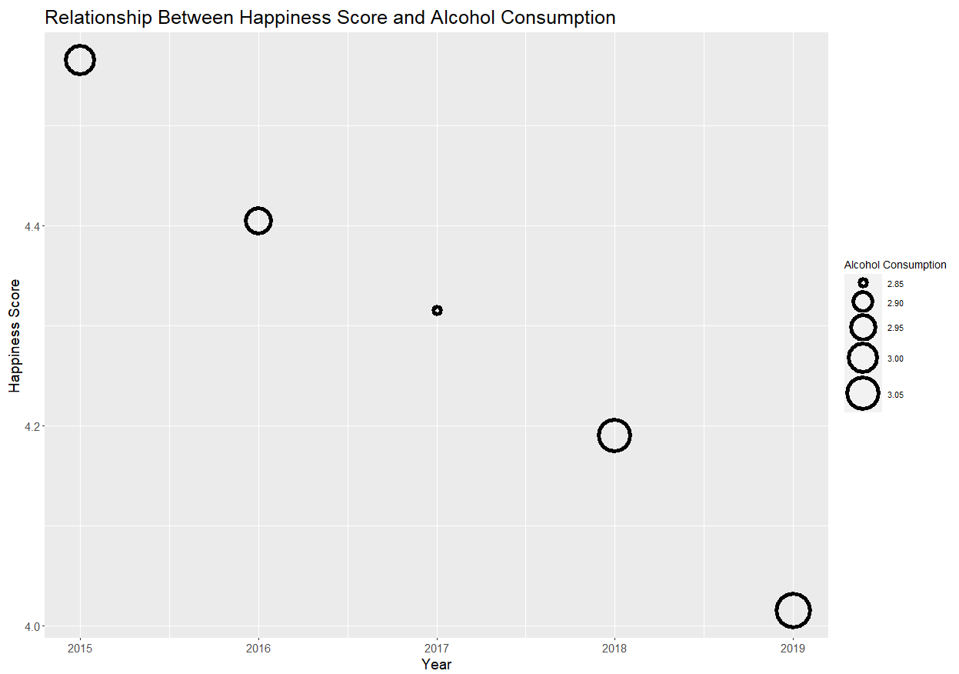
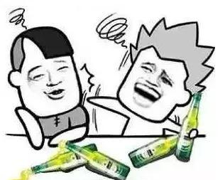
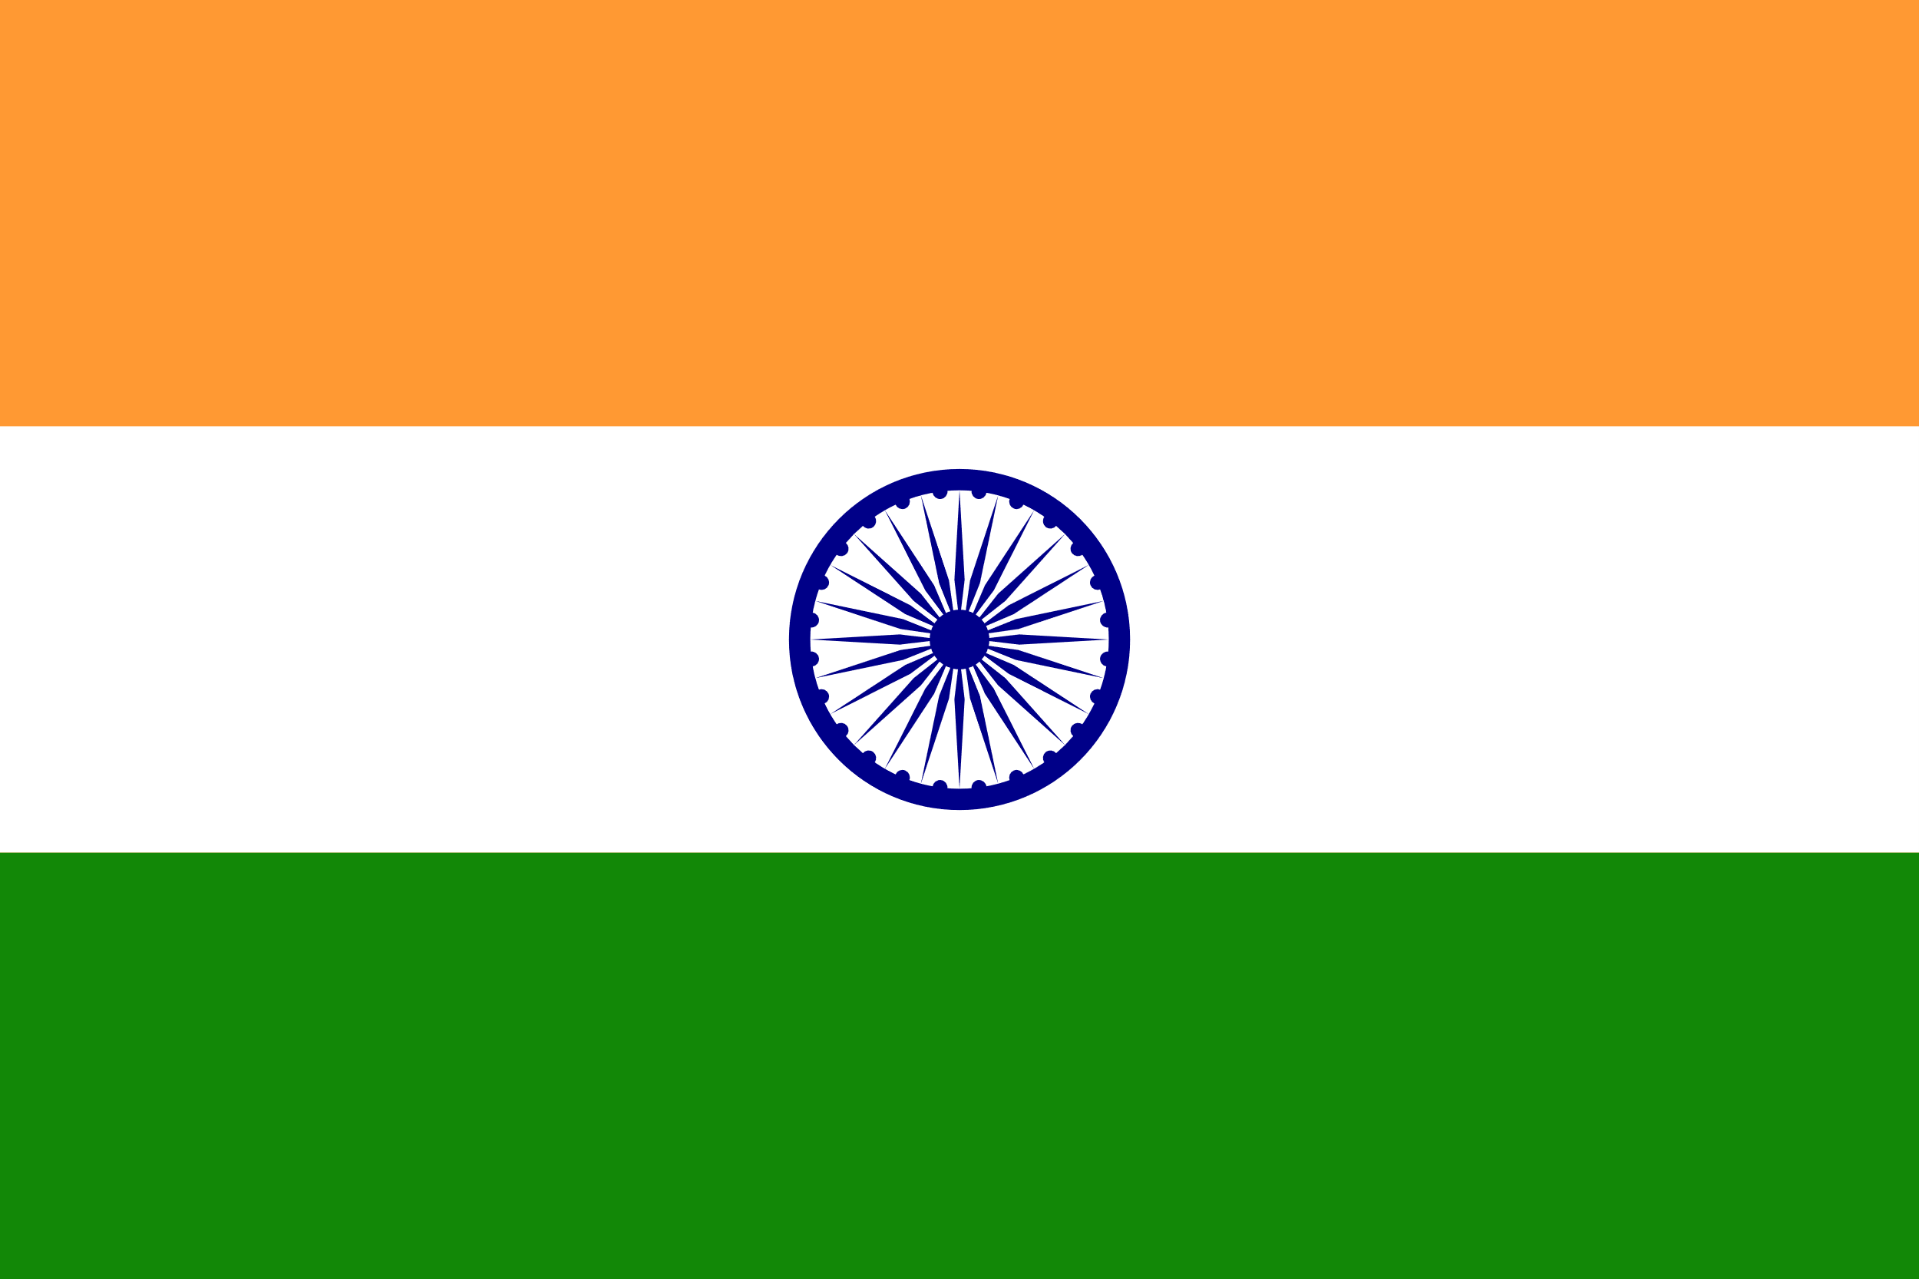
For India
Parabola?
Year: 2015-2019
As the picture shows, higher happiness score corresponds to higher alcohol consumption. Conversely, lower happiness score also corresponds to higher alcohol consumption. People drink the least in middle happiness score.

Slide 12
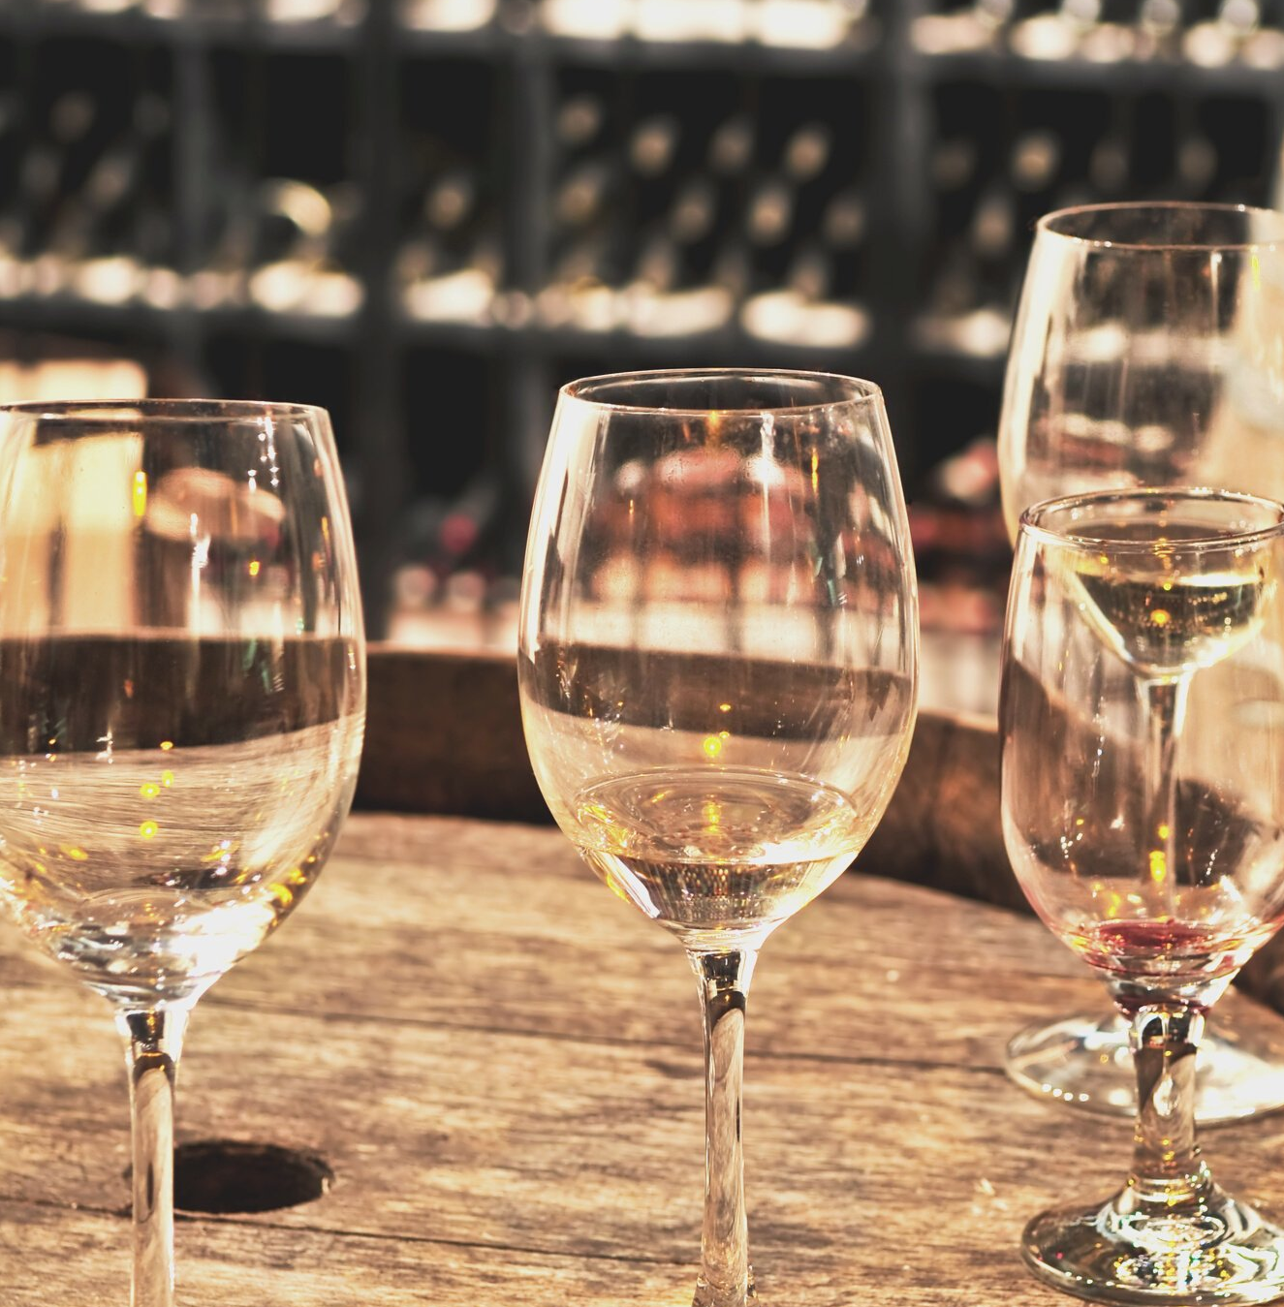
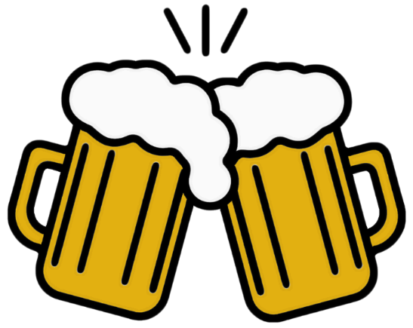
Conclusion and Discussion
1) Which country has the most alcohol consumption?
2015: Estonia, 2016: Estonia, 2017: Estonia, 2018: Latvia, 2019: Cook Islands
2) What kind of alcohol does each country like the most?
3) Which country is the happiest?
2015: Switzerland, 2016: Denmark, 2017: Norway, 2018: Finland, 2019: Finland
4) How does alcohol consumption relate to happiness score?
For the whole world, it seems that the more you drink, the happier you are. But, the situation is not the same in each country. The happiness score depends on varied factors.
Cheers!!

Slide 13
Team Collaboration
Keer Ma
Weikun Zhuang
Yuanyi Xie
Xiaoya Gao
Alcohol
Consumption
Part
Alcohol
Type
Part
Happiness
Scores
Part
Relationship
Part
25%
25%
25%
25%

Slide 14
Thanks for Listening
Q & A

